Slide 1
Credit Risk Scoring Model
Predicting Mortgage Default Using Freddie Mac Loan-Level Data
Sauravkumar Pandya
&
Dharmin Patel
| Advisor: Dr. Prof. Humera Noor | University of Europe for Applied Sciences

Slide 2
Introduction & Motivation

Slide 3
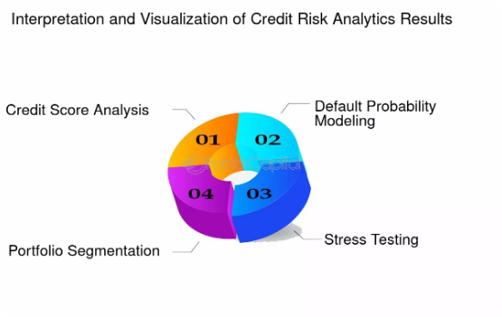
Introduction & Motivation
Credit risk assessment is critical for financial stability. Traditional rule-based models often struggle to capture the non-linear relationships inherent in modern borrower behavior.
This research leverages machine learning and Freddie Mac's loan-level dataset to develop an interpretable, accurate predictive model for mortgage defaults, providing essential insights for fintech risk management.

Slide 4
Problem Statement

Slide 5
Research Goals
✅ Objective: Build a machine learning model to predict mortgage default within 24 months.
✅ Dataset: Freddie Mac Single-Family Loan-Level files (2023–2025).
✅ Approach: Integration of origination and performance data to engineer risk-representative behavioral features.
✅ Goal: Enhance predictive accuracy and ensure model interpretability via SHAP/Explainable AI.

Slide 6
Methodology & Data

Slide 7


Dataset Composition
Origination Data
Performance Data
Captures static borrower profiles at time of issuance: FICO score, LTV, DTI ratios, interest rates, and geographic property state.
Contains dynamic financial history: Monthly payment records, delinquency status, and specific loan modification histories.

Slide 8
Models & Analysis

Slide 9
Predictive Performance Metrics
Metric | Logistic Regression | XGBoost
AUC-ROC | 0.78 | 0.86
KS Statistic | 0.34 | 0.47
Gini Coefficient | 0.56 | 0.72

Slide 10
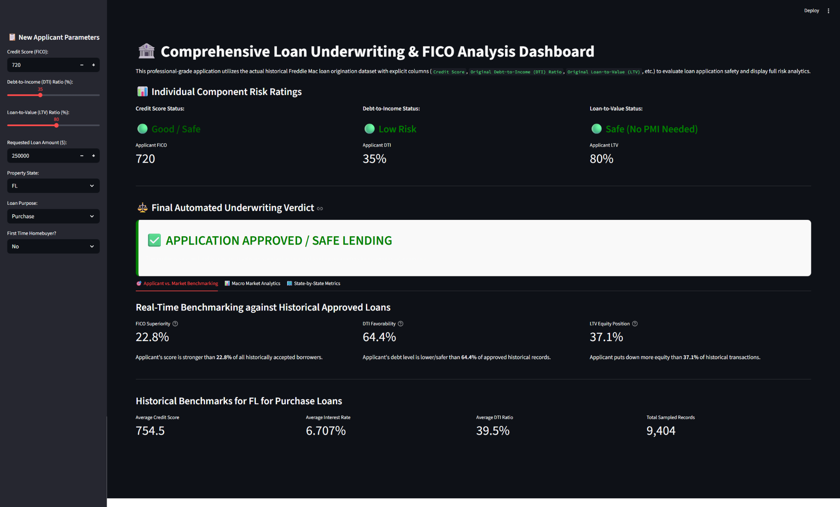
Streamlit Underwriting Dashboard
Deployed a professional Streamlit dashboard for real-time risk assessment.
Features:
•
Instant Individual Component Risk Ratings (FICO, DTI, LTV)
•
Automated Underwriting Verdicts
•
Real-time Benchmarking against historical approved loans

Slide 11
Conclusions

